Slide 1
Yale Graduate Students
Your 2023 Delta Dental Plans
August 17, 2023
1pm Webinar

Slide 2
Dental Benefits – Update
No plan changes – both Basic and Enhanced Plans will be offered again this year.
Remember – The Delta Website is mobile enabled so it’s always with you.
ID Cards will be mailed to your home. A digital copy is also available on the Delta Dental Website or on App.

Slide 3
Getting the most from your Delta Dental benefits
Available networks
Your dental plans
ID cards
Member experience
Contact Delta Dental
Oral health
Additional plan information

Slide 4
Delta Dental PPO Plus Premier™ nationwide networks
If you use a Delta Dental PPO™ dentist
Your out-of-pocket costs will be lowest for services if you use a participating PPO dentist.
Your annual maximum stretches further because the PPO dentists' fees are lower.
Participating dentists may not charge more than Delta Dental’s allowed charges, and are paid directly by Delta Dental for covered services.
If you use a Delta Dental Premier® dentist
Our largest nationwide network.
Your out-of-pocket costs will be higher, and your plan maximum will not go as far, since Premier dentists' fees are not as discounted as PPO dentists
Participating dentists may not charge more than Delta Dental’s allowed charges, and are paid directly by Delta Dental for covered services
You may use dentists that do not participate with Delta Dental
You are responsible for submitting the claim
You are responsible for making payment to the dentist
Your out-of-pocket costs are highest when you use non-participating dentists
Visit www.DeltaDentalCT.com/FAD
to find a dentist.
Choosing dentists with the “Greater Savings” icon helps you keep more money in your pocket.

Slide 5
Overview of Benefit Plans
Notes:
• If under 2 lines, increase the font size up to 54pt
• The font size should never go below 36pt

Slide 6
Delta Dental PPO Plus Premier™ Basic Plan
Yale Graduate & Professional Student Plan Group #04255 | If a Delta Dental PPO™ Dentist is Used (In-Network) | If a Delta Dental Premier® is Used (In-Network) | If a Non-Participating Dentist is Used (Out-Of-Network)
Preventive & Diagnostic Exams Cleanings Bitewing X-Rays Full Mouth X-Rays Fluoride Treatments (Frequency limitations apply) Space Maintainers | 100% | 100% | 100%
Basic Fillings Simple Extractions | 80% | 50% | 50%
Annual Maximum (per person) | $1,000 | $500 | $500
Annual Deductible* Per Person Family Maximum Waived for | $50 $100 Preventive & Diagnostic | $50 $100 Preventive & Diagnostic | $50 $100 Preventive & Diagnostic

Slide 7
Delta Dental PPO Plus Premier™ Enhanced Plan
Yale Graduate & Professional Student Plan Group #04255 | If a Delta Dental PPO™ Dentist is Used (In-Network) | If a Delta Dental Premier® is Used (In-Network) | If a Non-Participating Dentist is Used (Out-Of-Network)
Preventive & Diagnostic Exams, Cleanings Bitewing X-Rays, Full Mouth X-Rays Fluoride Treatments (Frequency limitations apply) Space Maintainers | 100% | 100% | 100%
Basic Fillings, Simple Extractions | 80% | 50% | 50%
Basic Sealants | 80% | 80% | 80%
Basic Root Canals (Endodontics) Periodontics Oral Surgery | 50% | 50% | 50%
Major Crowns & Gold Restorations Bridgework Full & Partial Dentures Repair of Dentures | 50% | 50% | 50%
Annual Maximum (per person) | $1,500 | $1,000 | $1,000
Annual Deductible* Per Person Family Maximum Waived for *There is a separate annual deductible for both Basic and Major Services. | $50 $100 Preventive & Diagnostic | $50 $100 Preventive & Diagnostic | $50 $100 Preventive & Diagnostic

Slide 8
Delta Dental Coverage if outside of the USA
Should a Graduate Student or an enrolled family member need services while outside of the USA how does the plan work?
Member would need to pay the bill upfront then submit an out of network claim to Delta Dental.
We would need an international address on file for reimbursement of claims paid by the member upfront.
If charges incurred with foreign currency we would covert and pay out in US currency.
Services paid in accordance to the out of network benefits for the plan selected.

Slide 9
Member Experience

Slide 10
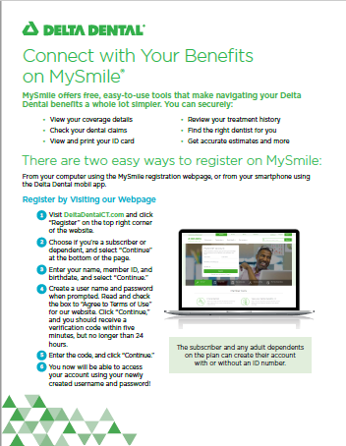
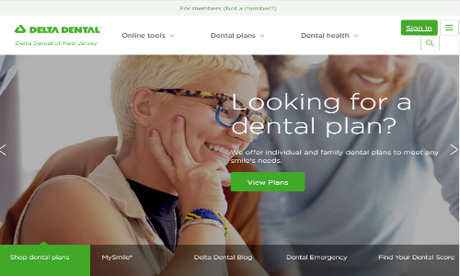
Delta Dental Website
Register and log into your My Smile® account at DeltaDentalCT.com to access your dental benefits information
Use the same log in information to access your dental benefits information in the Delta Dental App
Need a dentist? Click our ‘Find a Dentist’ to search for a dentist near you
Having trouble?
Watch this!
Step-by-Step
Website Registration

Slide 11
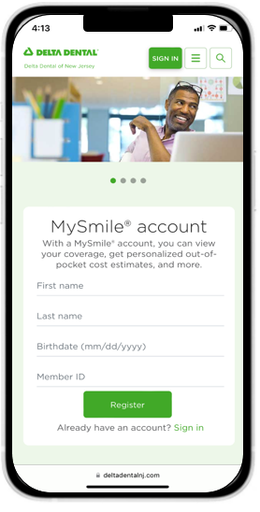
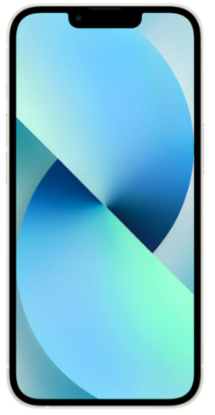
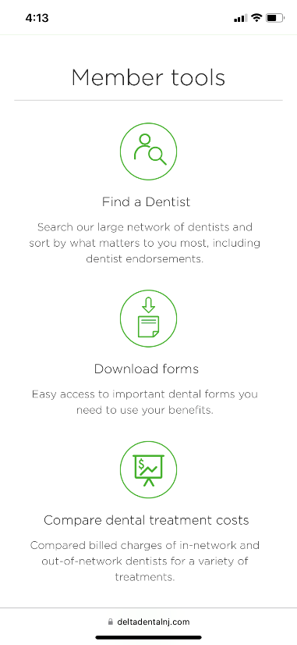
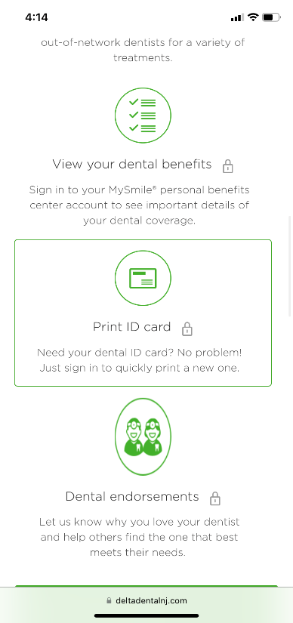
Member Tools
Connect with Delta Dental
Website – Mobile Enabled
ID Card
Find a Dentist
Save Your Preferred Dentist
Member Dashboard
Review Claims & Coverage
Cost Estimator
LifeSmiles Score
Dentist Endorsements

Slide 12
Dental emergency? Use our Virtual Visits service!
Delta Dental Virtual Visits, delivered by TeleDentistry.com, provides 24/7 access to a dentist, 365 days a year, for our members.
You can use Delta Dental Virtual Visits when:
having a dental emergency while on vacation, during holidays, or away from home
needing access to a licensed dentist after hours or if your dentist is unavailable
having a dental emergency and you do not have an established dentist
You should always try to access your regular dentist before using the Virtual Visits service.
To get started, call our 24/7 hotline at 866-443-1882 or visit www.DeltaDentalCT.com/VirtualVisits.
Delta Dental’s Virtual Visits service is provided by Teledentistry.com. This service is a covered benefit in most Delta Dental of Connecticut plans for currently enrolled members.
Please note that a Virtual Visit is considered to be a “problem-focused exam” and counts as one of your annual examinations covered by your plan.

Slide 13
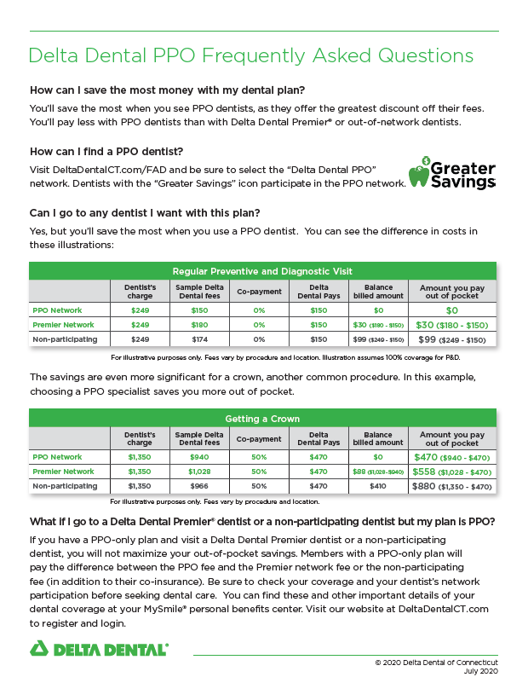
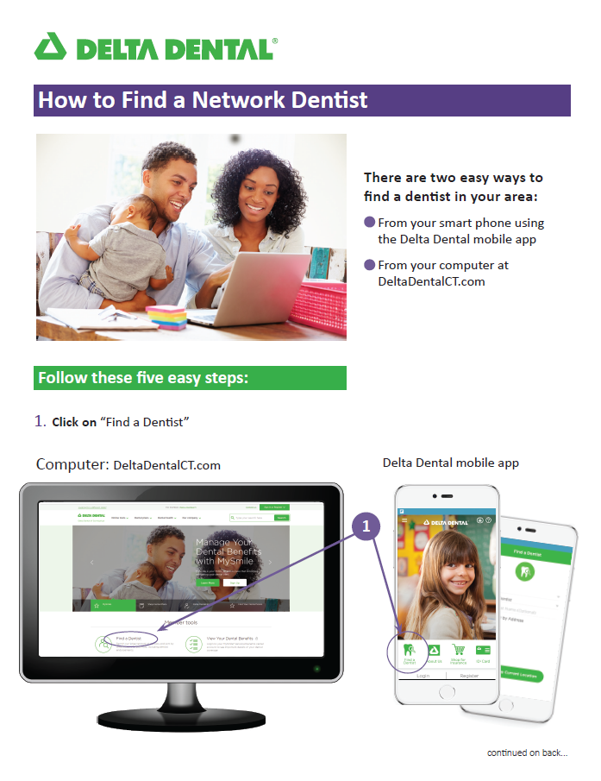
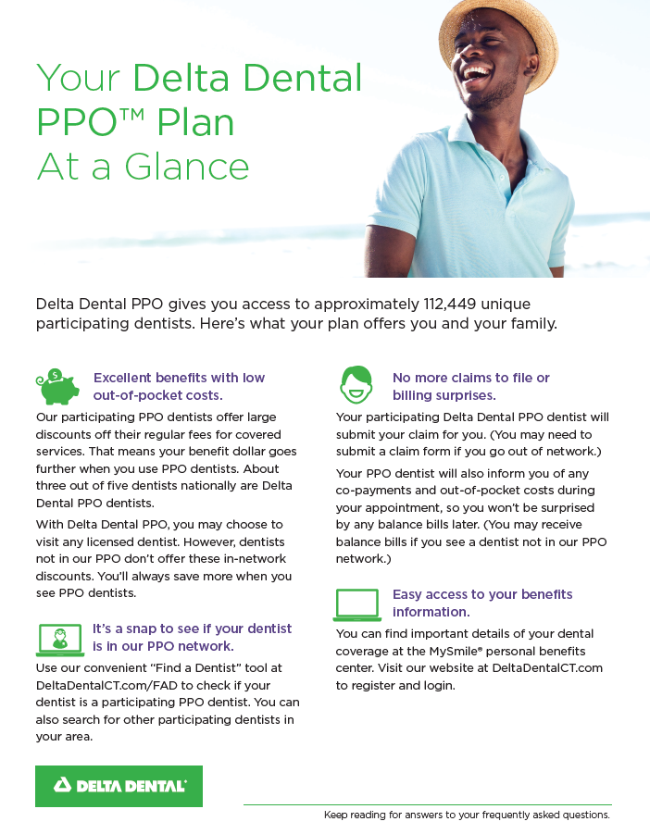
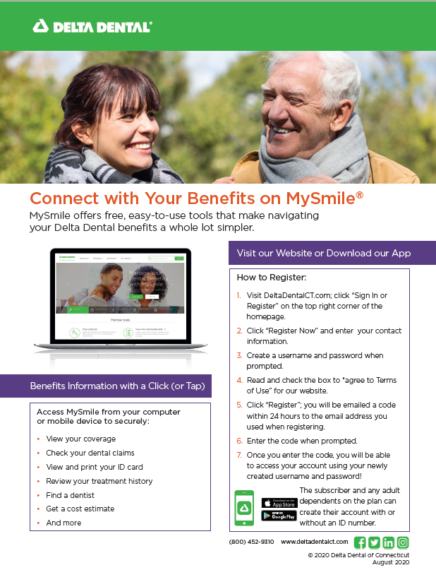
Virtual Open Enrollment Kit
Our Virtual Enrollment Kit will have answers to nearly all your enrollment questions!

Slide 14
Remove what does not apply
Dental ID card
Your ID card is available online in the MySmile Portal at www.DeltaDentalCT.com.
New enrollees will receive an ID card in the mail.

Slide 15
We want you to feel healthy and love your smile.
Taking good care of your teeth is an important part of taking good care of yourself.
Brush and floss your teeth twice a day
Go to the dentist twice a year
If you have pain in your mouth, don’t delay, visit your dentist
Tell your dentist about any medical conditions you have like diabetes, cardiac disease, or pregnancy
Protect your teeth from injury – wear a mouth guard when playing sports
Find a dentist that is conveniently located for you that offers hours that work for you and your family

Slide 16
Enrollment
There is a one-time enrollment/re-enrollment period between August 15 – September 15. Students receive an email communication with plan information, costs, enrollment deadline, and a link to enroll/re-enroll on or around August 15.
Website opens August 15
www.gradprofdenteye.yale.edu
Enhancements to website include:
a better look & feel,
and year-round access to check which plan(s) you enrolled in.
Confirmation email is sent when enrollment and payment successfully completed
No changes, plan upgrades, downgrades or cancellations after enrollment and payment are successfully completed
Website closes September 15 – no late enrollments

Slide 17
Payment options
Payment of annual premiums must be completed at the time of enrollment. There are two options to choose from:
1. Pay by major credit card (Visa, Mastercard, Discover or American Express)
One & done
2. Charge to Student Account
Multiple steps and check-ins required
Before charging the premium to your student account, you must first have enrolled in the Yale Charge Account Plan.
SIS -> Student Accounts tab -> Charge Account Authorization
It is your responsibility to be aware of and pay charges to your student account on time.
Late fees may apply if charges to your student account are not paid in a timely manner.
There is a monthly email notification of any balance due.

Slide 18
Your Resources – Connect with Delta Dental
Delta Dental PPO Plus Premier Plan
(Group #04255)
Customer Service 800-452-9310
Call or go online for these services:
Verify eligibility
Review benefits
Look up claim payments
Find a dentist
Cost Estimator – on mobile app
Print an ID card – or have it on your phone
Website: www.deltadentalct.com

Slide 19
Questions?
Log into the MySmile® portal
or
Contact us at 800-452-9310

